Slide 1
Web Accessibility
By Sam Gordon

Slide 2
What is accessibility
The ability for people with disabilities to navigate a web page using assistive programs such as screen readers
Short hand - a11y

Slide 3
Basic concepts
Color contrast – Color blindness
Font size
Design focus states – People who use the keyboard to select different parts of the website
Form Labels
Alt tags – explains what is in an image

Slide 4
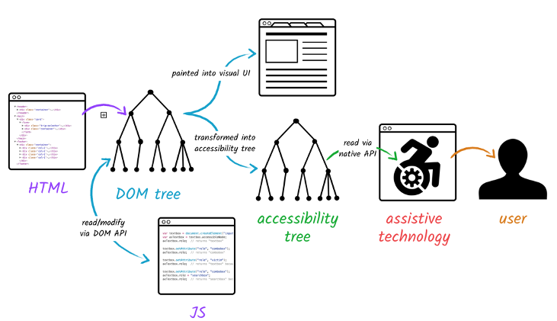
HTML Accessibility Tree

Slide 5
Web Content Accessibility Guidelines - WCAG
Ratings:
A – Lowest
AA – Mid Range
AAA – Highest
W3.org – WCAG 2.1 standards
WebAIM checklist

Slide 6
Affordance
Affordances or offer or afford a person the opportunity to perform an action
Visual Affordances
Buttons look like buttons
Design Affordances
Input boxes have labels so people know what to put in the box

Slide 7
Accessibility Elements
Use the correct semantic elements when building a webpage
Example use a button and not a div
Use H1-H6 in order on the page
Use accurate ALT descriptions for images

Slide 8
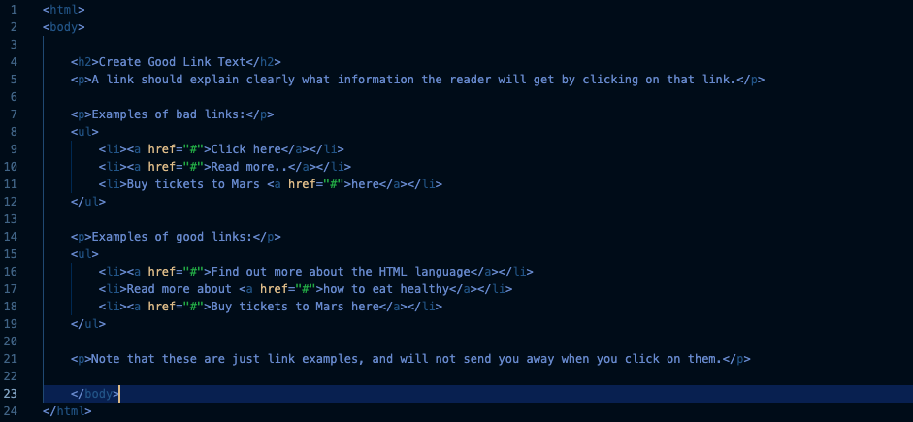
Example of accessible links

Slide 9
ARIA
Accessible Rich Internet Applications
Changes what a screen reader will announce to a user
Will not change functionality
<button id=“hamburger”
aria-label=“Main Menu”
</button>

